Slide 1

PLAY AND LEARN​
Stanislava Andonova, Kristina Bolashikova, Zhenya Yordanova ,Yavor Karakolev
Vocational School for Computer Programming and Innovations​

Slide 2
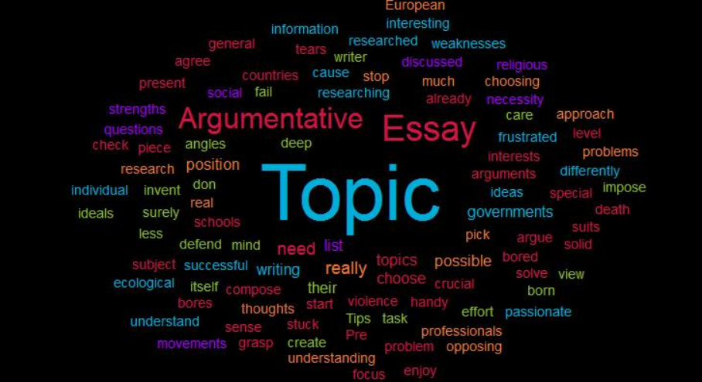
Summary
Description of the application

Slide 3
Milestones in the realization

Slide 4

Deciding what to do
01
Searching for similar ideas
02
Programming
03
Testing
04

Slide 5






Used resources

Slide 6
Conclusion

Slide 7
Thanks for your
attention!

